Slide 1
ONLINE PIZZA SHOP
GRAB YOUR PIZZA NOW

Slide 2

ONLINE PIZZA
MINI PROJECT
Guide: Rajalakshmi K.R.
Submitted by
Anathu Suresh
Blessin Mathew
Eldho M.S.
Abhijith P.R.
Abijith Anil

Slide 3

INDRODUCTION
We are dealing with the project on online pizza shop. The central concept of this application is to allow the customers to shop pizzas virtually through internet.it's very user-friendly and safe.

Slide 4

SYSTEM ANALYSIS

Slide 5

SYSTEM ANALYSIS
System analysis is conducted for the purpose of studying a system or its parts in order to identify its objectives.Finds the cons of existing system and make an proposed system

Slide 6
EXISTING SYSTEM
Existing system is the physical shop and Their works are done manually.Also customers need to visit shop directly.thus it has some problems

Slide 7

DISADVANTAGES OF EXISTING SYSTEM
Time consuming
Less user friendly
Description of product limited
Difficult to identity required product
More manpower required

Slide 8

PROPOSED SYSTEM
The drawbacks of the existing system can be solved by new system.that is online pizza delivery
User friendly
Save time

Slide 9
ADVANTAGES OF PROPOSED SYSTEM
Reliable
Fast
Better Service
User friendly
Greater efficiency
Ease of use

Slide 10
FEASIBILITY STUDY

Slide 11

FEASIBILITY STUDY
A feasibility study is an analysis that takes all of a project's relevant factors.
There are 3 types of feasibility studies :
Economic feasibility
Technical feasibility
Social feasibility

Slide 12

Economic feasibility
• Cost is found to be lesser compared to existing system
• staff training cost is decreased
• Workload can be decreased.
Technical feasibility
The proposed system can be expanded based on the user requirements.
The new system can handle large volume of data

Slide 13
Social feasibility
The proposed system is designed in such a way that even a person who has less computer knowledge can interact with the system freely

Slide 14


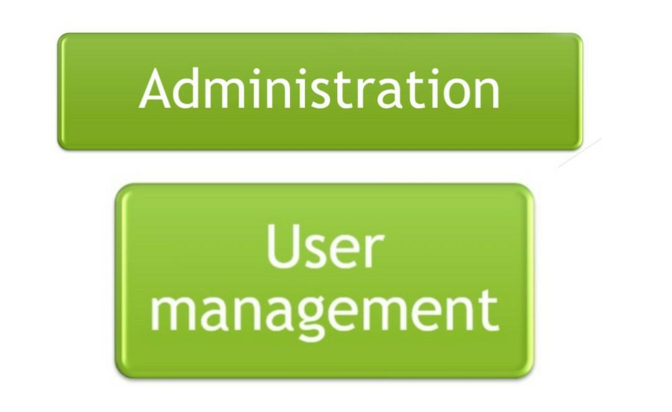
MODULES

Slide 15
ADMINISTRATION
PROCESS OF ADMINISTRATION
Product Management
Delivery Management

Slide 16

USER MANAGEMENT
PROCESS OF USER MANAGEMENT
Order Management
Feedback

Slide 17
DATABASE DESIGN

Slide 18
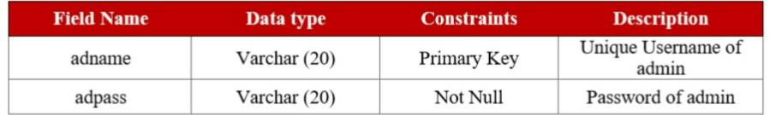
ADMIN LOGIN

Slide 19
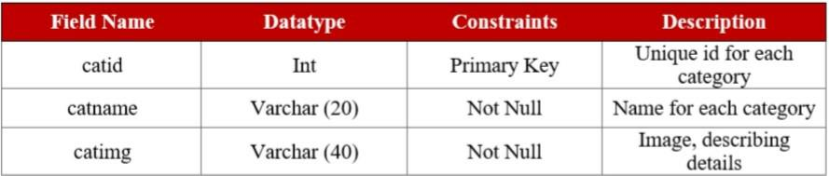
CATEGORIES

Slide 20
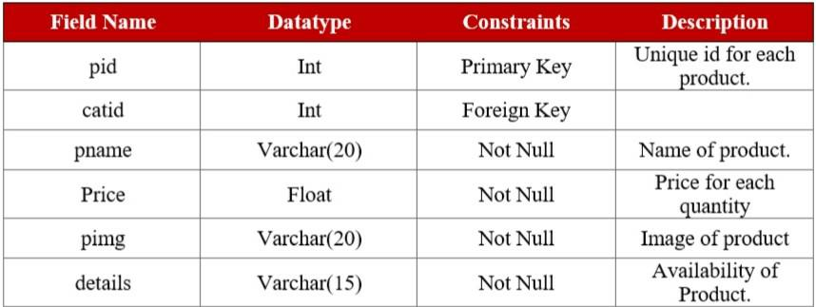
PRODUCTS

Slide 21
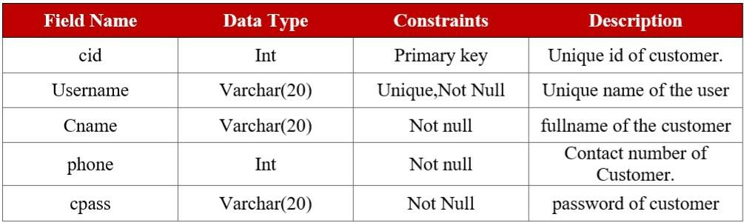
CUSTOMER DETAILS

Slide 22
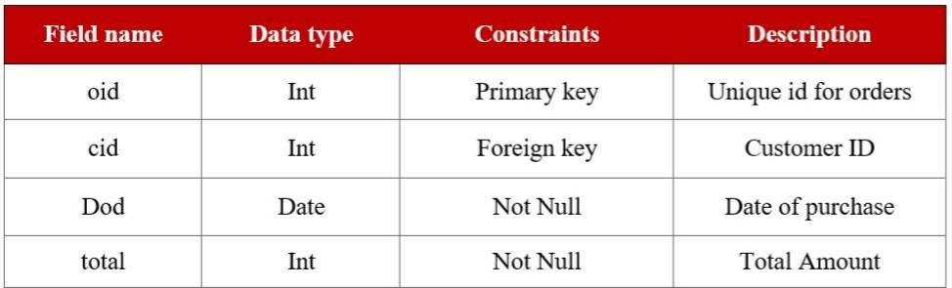
ORDERS

Slide 23
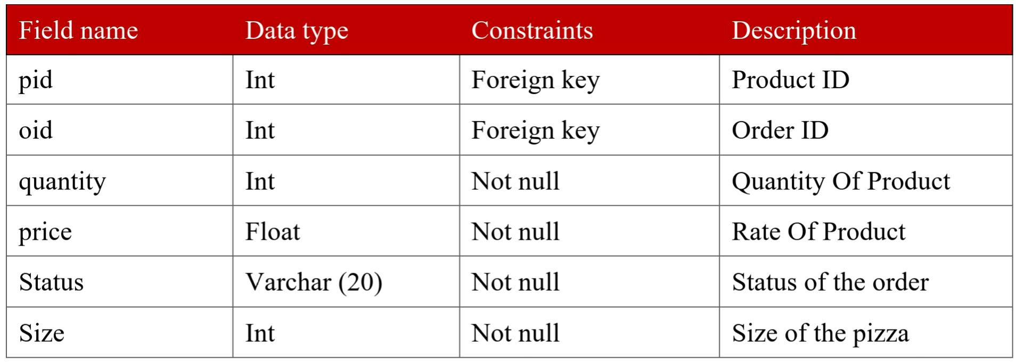
ORDERDETAILS

Slide 24
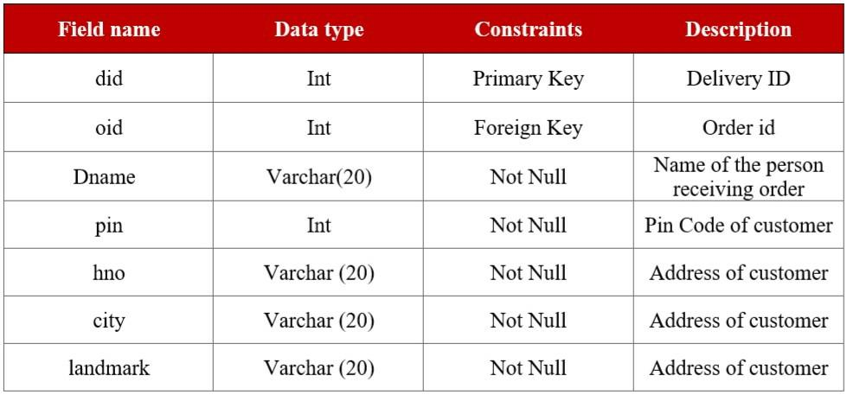
DELIVERY DETAILS

Slide 25
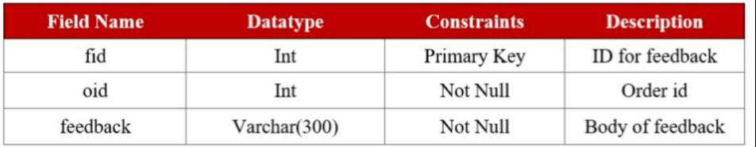
FEEDBACK

Slide 26
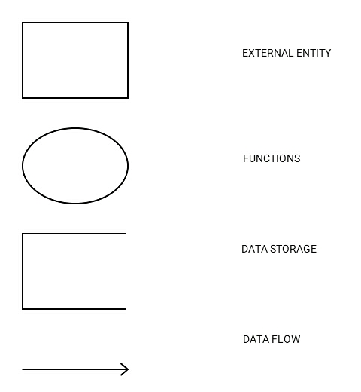
DATA FLOW DIAGRAM

Slide 27
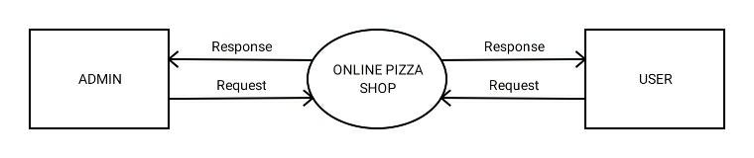
CONTEXT DIAGRAM

Slide 28
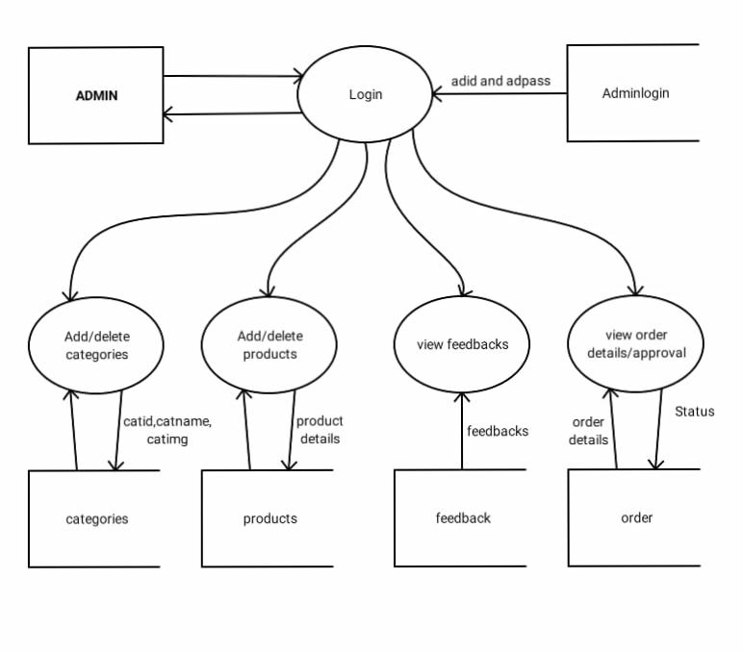
DFD FOR ADMIN

Slide 29
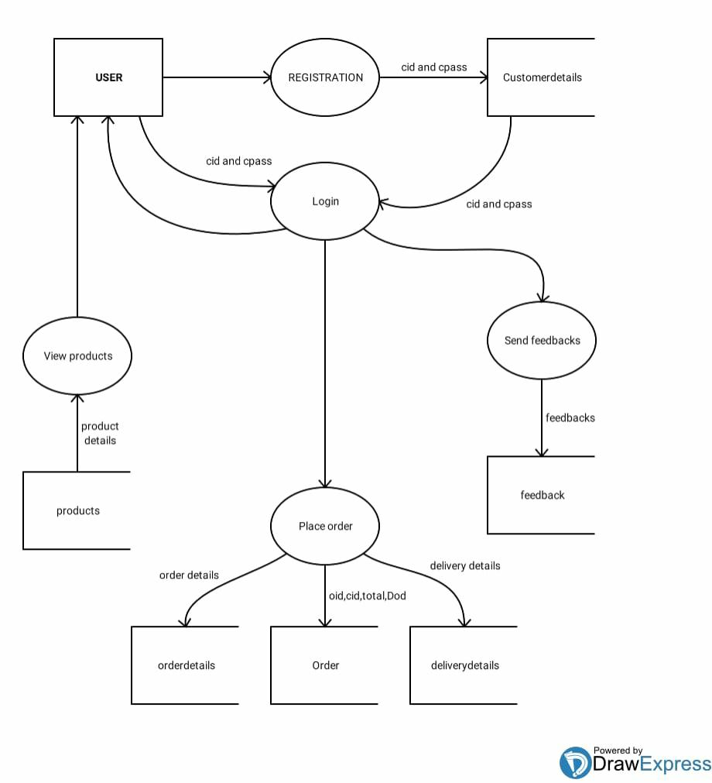
DFD FOR
USER MANAGEMENT

Slide 30

CONCLUSION
The application for online pizza shop is easily accessible, informative and helpful .The application is user-friendly and very simple there by a common man can easily access it .This system allows customers to order pizza of their own choice. It is also upgradable in future

Slide 31
REFERENCE
Database design concept(Henry korth)
Software Engineering (K.K Aggarwal and Yogesh Singh)
System analysis and design (Elias M award)
https://www.freeprojectz.com

Slide 32
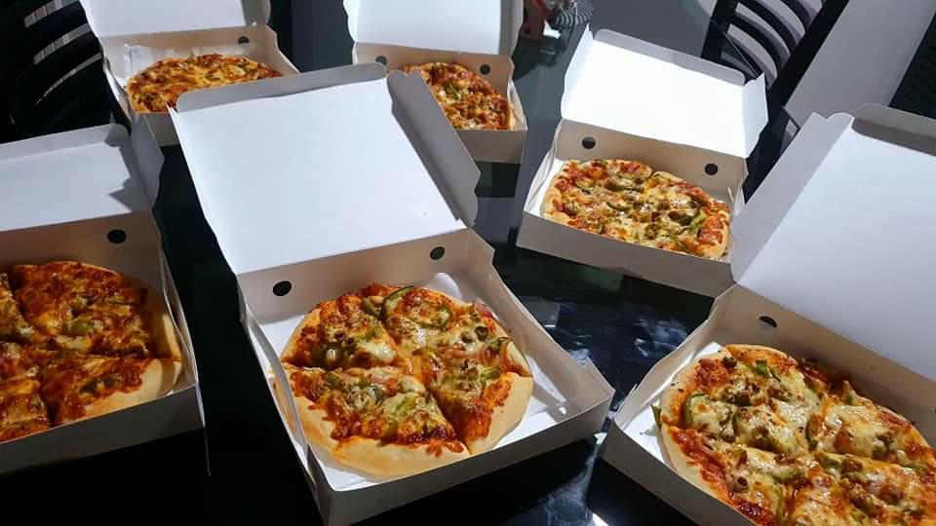
THANK YOU

